Slide 1
State Innovations in Delivery and Payment Reform
CDR Frances R. Jensen, MD
Deputy Director,
State Innovations Group,
Project Officer, ME SIM
CMMI
December 8, 2015

Slide 2
Questions to Run On…
  Where are we now?
  Where are we going?
  How does SIM fit in to all this delivery system reform?
  What are some options for innovation sustainability?
Notes:
Where have we been and where are going?
What are we going to talk about to day (questions to run on?)

Slide 3
Better.
Smarter.
Healthier.
So we will continue to work across sectors and across the aisle for the goals we share: better care, smarter spending, and healthier people.
Notes:
30K level

Slide 4
Our guiding principle
SIM is Everything
and
everything is sim

Slide 5
Where are we now…'Jaw-dropping': Medicare deaths, hospitalizations AND costs reduced
Sample consisted of 68,374,904 unique Medicare beneficiaries (FFS and Medicare Advantage).
 | 1999 | 2013 | Difference
All-cause mortality | 5.30% | 4.45% | -0.85%
Total Hospitalizations/ 100,000 beneficiaries | 35,274 | 26,930 | -8,344
In-patient Expenditures/ Medicare fee-for-service beneficiary | $3,290 | $2,801 | -$489
End of Life Hospitalization (last 6 months)/100 deaths | 131.1 | 102.9 | -28.2
Findings were consistent across geographic and demographic groups.
Mortality, Hospitalizations, and Expenditures for the Medicare Population Aged 65 Years or Older, 1999-2013; Harlan M. Krumholz, MD, SM; Sudhakar V. Nuti, BA; Nicholas S. Downing, MD; Sharon-Lise T. Normand, PhD; Yun Wang, PhD; JAMA. 2015;314(4):355-365.; doi:10.1001/jama.2015.8035
Notes:
Wicked good start

Slide 6
Improving the way providers are incentivized, the way care is delivered, and the way information is distributed will help provide better care at lower cost across the health care system.
Where are we going…Delivery System Reform requires focusing on the way we pay providers, deliver care, and distribute information
“
{
}
FOCUS AREAS
Pay
Providers
Deliver
Care
Distribute
Information
Source: Burwell SM. Setting Value-Based Payment Goals ─ HHS Efforts to Improve U.S. Health Care. NEJM 2015 Jan 26; published online first.

Slide 7
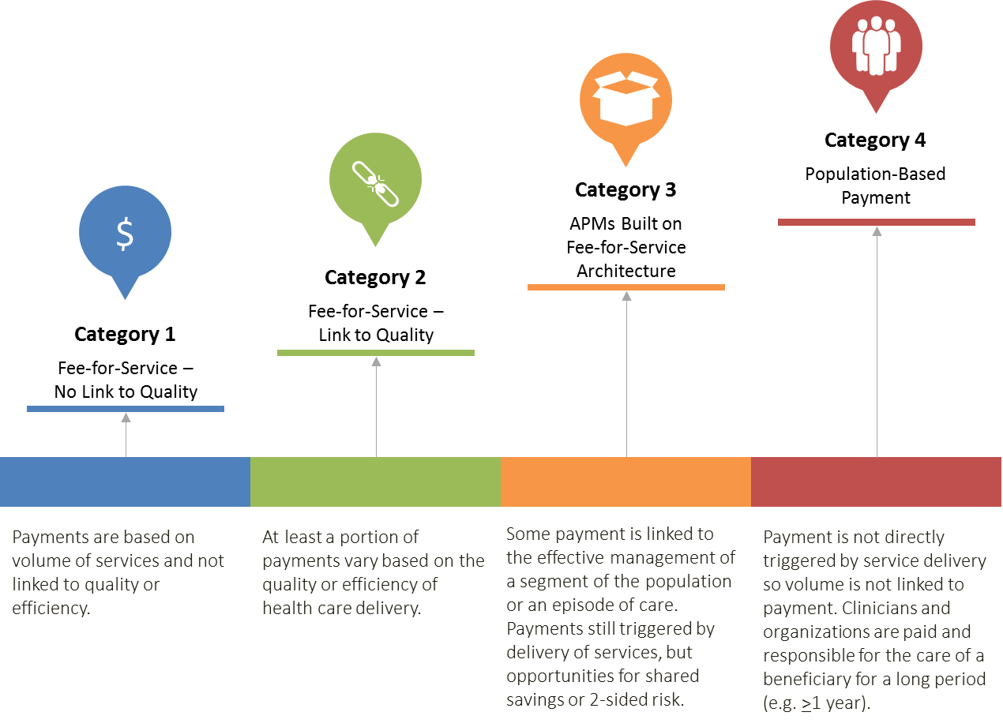
CMS Payment Framework
Rajkumar R, Conway PH, Tavenner M. CMS: Engaging multiple payers in payment reform. JAMA. 2014 May 21: 311(19):1967-8.
Notes:
Mechanism

Slide 8
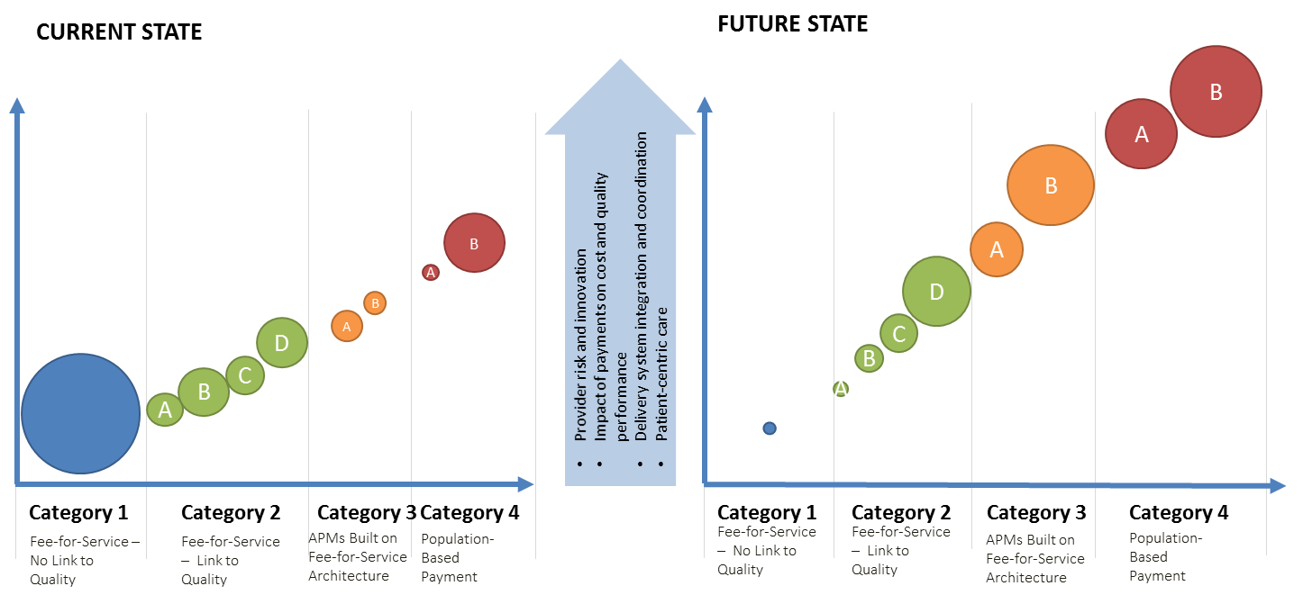
Pathway to Patient-Centered Care
13

Slide 9
Target percentage of payments in ‘FFS linked to quality’ and ‘alternative payment models’ by 2016 and 2018
Alternative payment models (Categories 3-4)
FFS linked to quality (Categories 2-4)
All Medicare FFS (Categories 1-4)
2016
2018
0%
~%
30%
50%
85%
90%
Goals

Slide 10
CMS is aligning with private sector and states to drive delivery system reform
CMS Strategies for Aligning with Private Sector and states
Convening Stakeholders
Incentivizing
Providers
Partnering
with States
Notes:
mechanism

Slide 11
The Health Care Payment Learning and Action Network will accelerate the transition to alternative payment models
Medicare alone cannot drive sustained progress towards alternative payment models (APM)
Success depends upon a critical mass of partners adopting new models
The network will
  Convene payers, purchasers, consumers, states and federal partners to establish a common pathway for success
  Identify areas of agreement around movement to APMs
  Collaborate to generate evidence, shared approaches, and remove barriers
  Develop common approaches to core issues such as beneficiary attribution
  Create implementation guides for payers and purchasers
Network Objectives
Match or exceed Medicare alternative payment model goals across the US health system
-30% in APM by 2016
-50% in APM by 2018
Shift momentum from CMS to private payer/purchaser and state communities
Align on core aspects of alternative payment design

Slide 12
CMMI plays an important role in driving Congressional policy
According to the Congressional Budget Office, federal spending on major health care programs in 2020 will be $200 Billion lower than predicted in 2010.

Slide 13
Our portfolio is defining how the industry needs to change
Pay Providers
Test and expand alternative payment models
Accountable Care
Pioneer ACO Model
Medicare Shared Savings Program (housed in Center for Medicare)
Advance Payment ACO Model
Comprehensive ERSD Care Initiative
Next Generation ACO
Primary Care Transformation
Comprehensive Primary Care Initiative (CPC)
Multi-Payer Advanced Primary Care Practice (MAPCP) Demonstration
Independence at Home Demonstration
Graduate Nurse Education Demonstration
Home Health Value Based Purchasing
Medicare Care Choices
Bundled payment models
Bundled Payment for Care Improvement Models 1-4
Oncology Care Model
Comprehensive Care for Joint Replacement
Initiatives Focused on the Medicaid
Medicaid Incentives for Prevention of Chronic Diseases
Strong Start Initiative
Medicaid Innovation Accelerator Program
Dual Eligible (Medicare-Medicaid Enrollees)
Financial Alignment Initiative
Initiative to Reduce Avoidable Hospitalizations among Nursing Facility Residents
Medicare Advantage (Part C) and Part D
Medicare Advantage Value-Based Insurance Design model
Part D Enhanced Medication Therapy Management
Deliver Care
Support providers and states to improve the delivery of care
Learning and Diffusion
Partnership for Patients
Transforming Clinical Practice
Community-Based Care Transitions
Health Care Innovation Awards
State Innovation Models Initiative
SIM Round 1
SIM Round 2
Maryland All-Payer Model
Million Hearts Cardiovascular Risk Reduction Model
Distribute Information
Increase information available for effective informed decision-making by consumers and providers
13
Health Care Payment Learning and Action Network
Information to providers in CMMI models
Shared decision-making required by many models

Slide 14
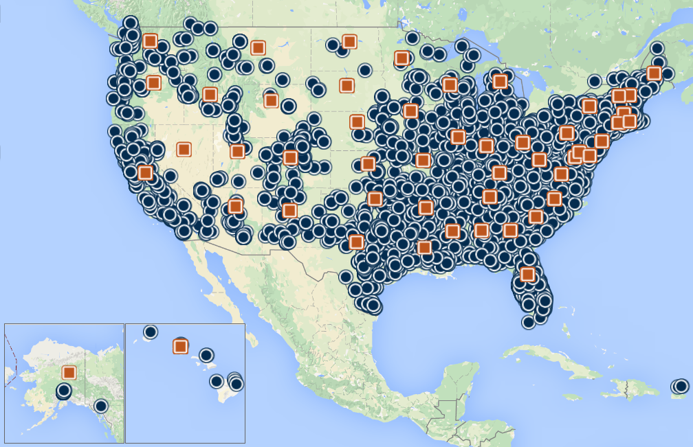
CMS has engaged the health care delivery system and invested in innovation across the country
Sites where innovation models are being tested
Models run at the state level
Source: CMS Innovation Center website, January 2015

Slide 15
Our guiding principle
SIM is Everything
and
everything is sim

Slide 16
State Innovation Model grants have been awarded in two rounds
CMS is testing the ability of state governments to utilize policy and regulatory levers to accelerate health care transformation
Primary objectives include
  Improving the quality of care delivered
  Improving population health
  Increasing cost efficiency and expand value-based payment
Six round 1 model test states
Eleven round 2 model test states
Twenty one round 2 model design awardees

Slide 17
SIM is ahead of the game…
SIM must reach a preponderance of care in the state
Primary Goal: Over 80% of payments to providers from all payers in the state are in value-based purchasing and/or alternative payment models by end of performance period
Quarterly Participation Metrics
  The total number of beneficiaries (individuals) receiving care through each value-based purchasing and/or alternative payment model supported by SIM (by type)
  The total number of providers participating in any value-based purchasing and alternative payment model supported by SIM (by type)
  The total % of payments to providers and beneficiaries receiving care by payment categories 1-4 (statewide)
Category 1 | Category 2 | Category 3 | Category 4
Fee-for-service with no link of payment to quality | Payment Linked to Quality | Alternative Payment Models | Population-based Payment

Slide 18

SIM must include multiple payers
Medicaid
State Employees Plans
Qualified Health Plans
Commercial Payers
Purchasers
Areas of Alignment:
Quality measurement
Payment methodology
Shared infrastructure & investments

Slide 19
Round 1 states are testing and Round 2 states are designing and implementing comprehensive reform plans
Round 1 States testing APMs
Round 2 States designing interventions
Patient centered medical homes
Health homes
Accountable care
Current CMMI objectives
  Establish project milestones and success metrics
  Review Operational Plans for launch of Test Year 1
  Establish and cement relationships amongst R1 and R2 states and TA partners
  Develop streamlined reporting system (thanks for your help!)
Episodes
Arkansas
Maine
Massachusetts
Minnesota
Oregon
Vermont

Slide 20
R1 test states are integrating community services and population health
Community services
Population health
CDC is working with states to develop state-wide, targeted population health plans that will integrate health and health care delivery systems
Arkansas
Piloting community health workers to address population health needs of underserved populations
Maine
Implementing e-Referral program linking primary care to community resources
Massachusetts
Testing ACOs, public health and social services working together at the community level
Minnesota
CCOs forming Community Advisory Councils to develop community health assessment and health improvement plans
Oregon
Vermont

Slide 21
Enabling Strategies
Comprehensive & Dynamic State Learning System
  Real time Peer to Peer Exchange
  Site visits
  TASC providing multiple resources
  Weekly Virtual sessions
  Affinity groups
    Workforce/CHWs
    Native Americans/Tribes
    Quality Metrics
    VBID
    Lots more
Office of the National Coordinator HIT State Resource Center
  APCD
  Meaningful use
  eCQM
  Interoperability Roadmap
  HIT/E Compendium
  Lots more

Slide 22

How do we keep the innovations going?
Sustainability
  Wicked big focus
  …for us and you
  Maine can lead the way…

Slide 23

SIM test states may submit Medicare participation ideas
CMS will rely on the following principles in assessing proposals for new and novel models that are:
Patient centered
Accountable for the total cost of care
Transformative (preponderance of payments)
Broad-based (preponderance of providers)
Feasible to implement
Feasible to evaluate

Slide 24
Program Areas for States to consider in their SIM ACO for Medicare Alignment
ACO Design Element | Description
Care Coordination | States should encourage effective care coordination in the ACOs across a range of primary care providers, specialists and suppliers in order to address patient needs while delivering high quality care
Provider/Supplier Org Structure | States should consider that ACOs have a diverse set of providers and suppliers with the capacity to coordinate care for an assigned patient panel
Governance & Leadership | ACOs should have a clearly defined governance structure that includes patient representatives , a diverse set of providers and suppliers
Quality Strategy | Alignment among the payers participating in the ACO model Focus on clinical processes, patient safety, population health, efficiency, care coordination and patient/family engagement
Attribution | Clear methodology for determining patient attribution to support care coordination, quality improvement and payment systems. Can be prospective, retrospective, voluntary, claims based
Payment Methodology | Clear methodology for benchmarking and risk sharing Consider using one sided risk sharing arrangements as vehicles to promote participation from newly formed ACOs while they learn to manage the risk of their patient population with a defined timeline for transitioning to two sided risk arrangements
Data Sharing | States should consider HIE/HIT needs and capacity of ACO providers and suppliers, ensure necessary DUAs

Slide 25
Program Areas for States to consider in their SIM PCMH for Medicare Alignment
Readmissions rate must come done to National levels
Primary Care Functions
Five primary care functions for practices that States should consider in their SIM PCMH : 1) risk stratified care management, 2) access and continuity, 3) planned care for population health, 4) Patient Engagement, 5) Coordination of Care and Services
States can build broad multi-payer participation including alignment on payment arrangement, attribution, data sharing, consistent performance metrics
States can consider robust data sharing with practices including requiring practices to have EHR certification, remove access to EHR, capability to receive and analyze data
States can incorporate shared learning to orient practices to understand model goals, train practices to understand / utilize data for decision-making, to foster peer-to-peer learning and provide support and guidance to build practice capabilities
States can consider alignment across payers, including Medicare, on quality metrics, quality reporting, and using quality to determine payment incentives
States can consider a payment methodology that includes provision of care management payments and how to hold practices accountable for total cost of care of attributed patients
Multi-Payer and provider participation
Data Sharing between payers and practices
Shared Learning
Quality Strategy
Payment Methodology

Slide 26
Maryland All-Payer Model saved $116M
Maryland is the nation’s only all-payer hospital rate regulation system
Model will test whether effective accountability for both cost and quality can be achieved within all-payer system based upon per capita total hospital cost growth
Hospitals began moving into All-Payer Global Budgets in July 2014
  95% of Maryland hospital revenue will be in global budgets
  All 46 MD hospitals have signed agreements
In year 1, the Maryland All-Payer Model saved $116M

Slide 27
What is “MACRA”?
The Medicare Access and CHIP Reauthorization Act of 2015 (MACRA) is a bipartisan legislation signed into law on April 16, 2015.
What does Title I of MACRA do?
  Repeals the Sustainable Growth Rate (SGR) Formula
  Changes the way that Medicare rewards clinicians for value over volume
  Streamlines multiple quality programs under the new Merit-Based Incentive Payments System (MIPS)
  Provides bonus payments for participation in eligible alternative payment models (APMs)
Notes:
Bullets edits

Slide 28

Better.
Smarter.
Healthier.
Frances.Jensen@cms.hhs.gov
410-786-2252
Questions?
Notes:
30K level

